Slide 1
Weather Effects on COVID-19
Corona Weather Reporters
Harpreet Ghag, Joshua Francisco, Madhuri Pyreddy, Micah Mercado, Michael Novella, Xavier Mercado
CSCI 191T Big Data Analytics

Slide 2
Introduction
COVID-19, or Coronavirus, originated from Wuhan, China in mid December 2019. It’s spread has caused a global pandemic in mid March 2020. Our group seeks to analyze how weather, including ozone and humidity, may have an effect on COVID-19.
It is also worth noting the 2003 SARS pandemic. SARS shares similarity to COVID-19 in its country of origin, climate, scale, and transmission.

Slide 3
Literature Review
There have been multiple studies done that back the idea that there is some correlations between the weather and the spread of the SARS-CoV-2 novel coronavirus[1][2][3][4][6][11][12].

Slide 4
Problems faced
We faced issues with obtaining current data. Our initial source of data used DarkSky for our Weather data. After being purchased by Apple, we had to move to a new source which gave us a big setback.
Since Covid-19 is so new there was lack of research of Covid-19 so we had to wait for some research to come out, that we could use for our analysis.

Slide 5
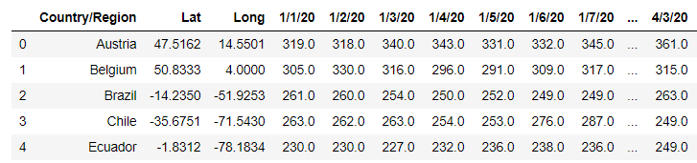
Ozone Levels - Data Set
We cleaned a large dataset, to have average ozone levels in countries with at least 10,000 cases as of April 20, 2020. We ended up with a list of 29 countries that we will analyze.

Slide 6
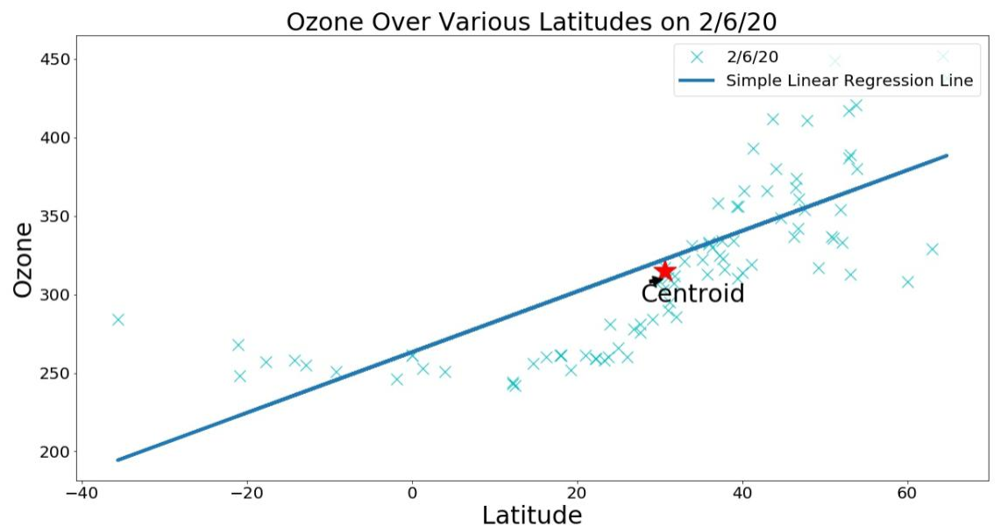
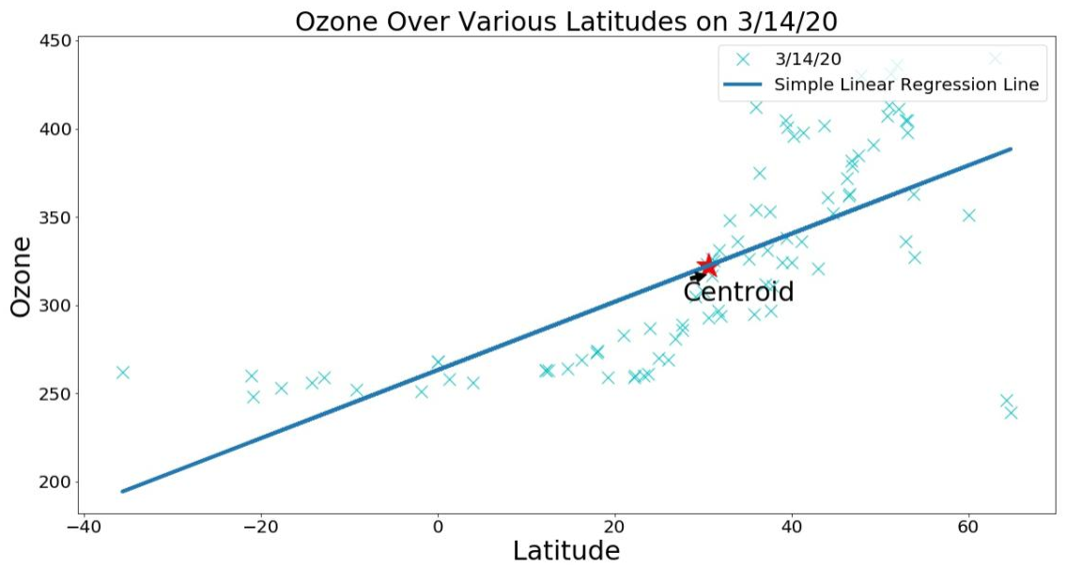



Slide 7
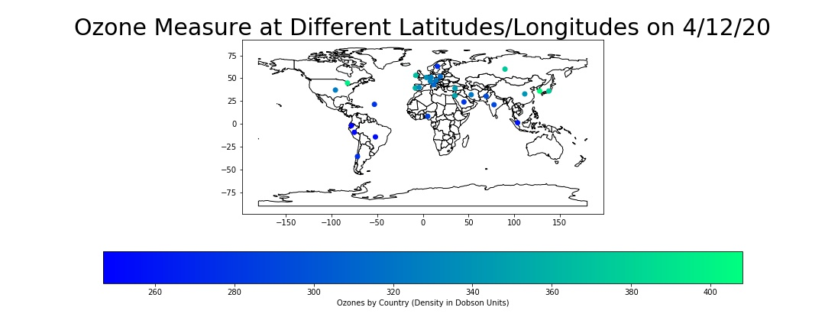
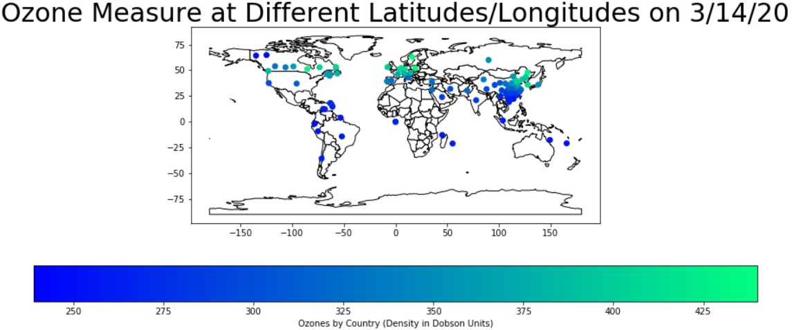

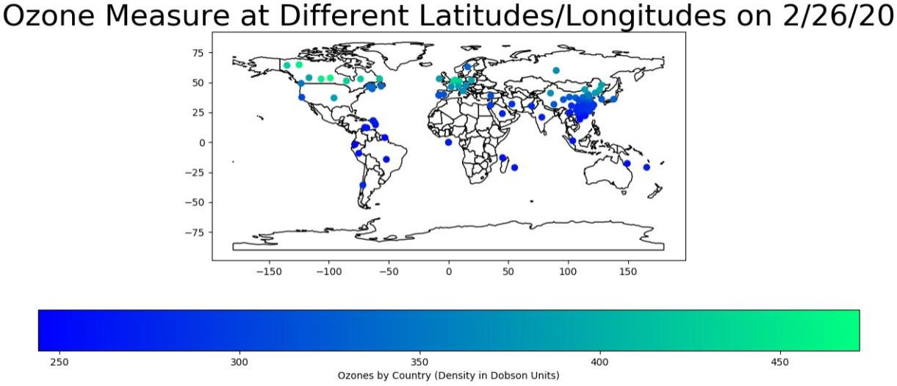

Slide 8
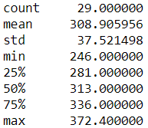
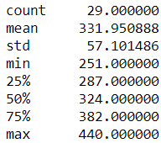
Ozone Levels Descriptive Analysis Globally
2/6/20 3/14/20

Slide 9
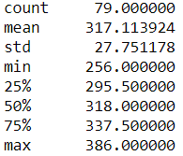
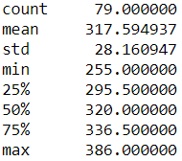
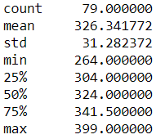
Ozone Levels Descriptive Analysis
Counties in California with means and standard deviation of their ozone, reveal that ozone is consistent within a 10% range. Using 79 days of data, from 1/1/2020 - 3/19/2020
Orange County
Los Angeles County
Santa Clara County

Slide 10
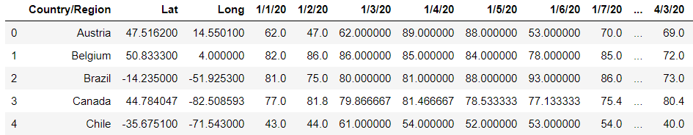
Humidity Levels - Data Set
Using the same methodology as Ozone, we cleaned data and choose the 29 countries with at least 10,000 cases as of April 20, 2020.

Slide 11
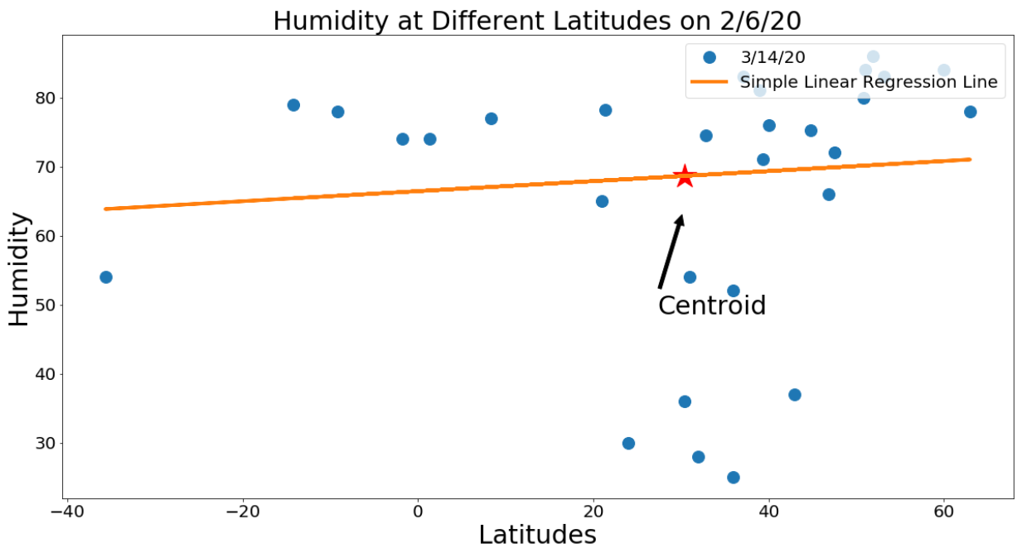
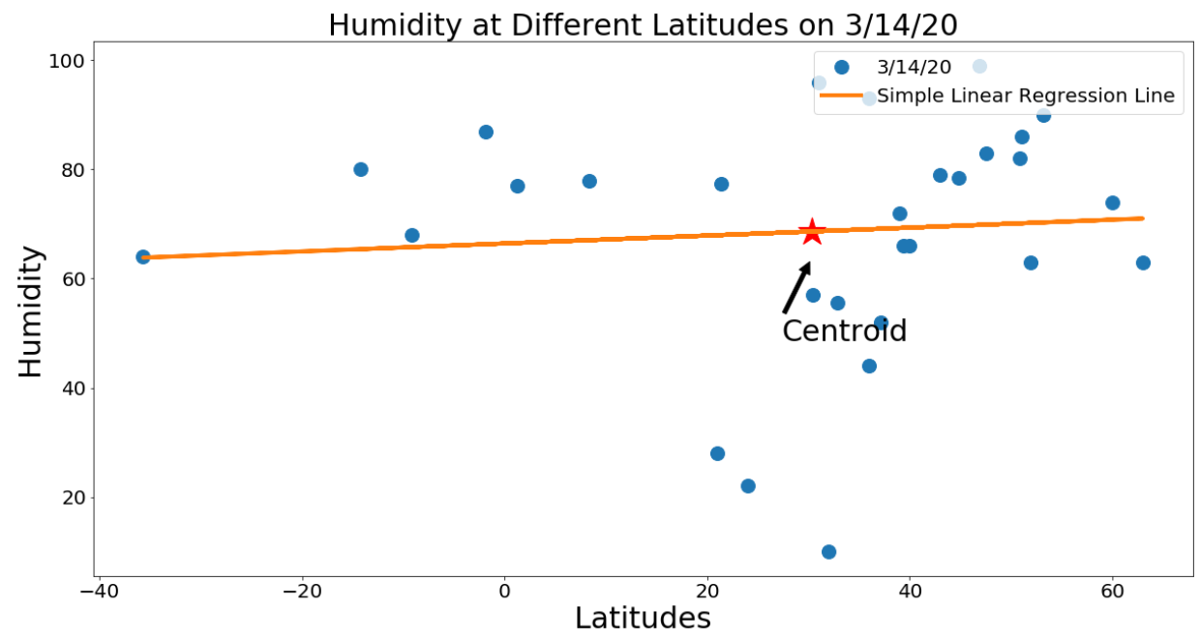



Slide 12
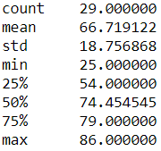
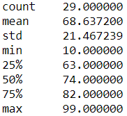
Humidity Levels Descriptive Analysis Globally
2/6/20 3/14/20

Slide 13
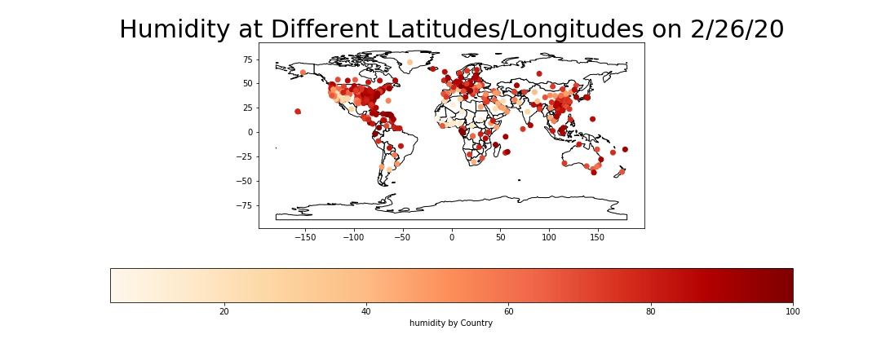
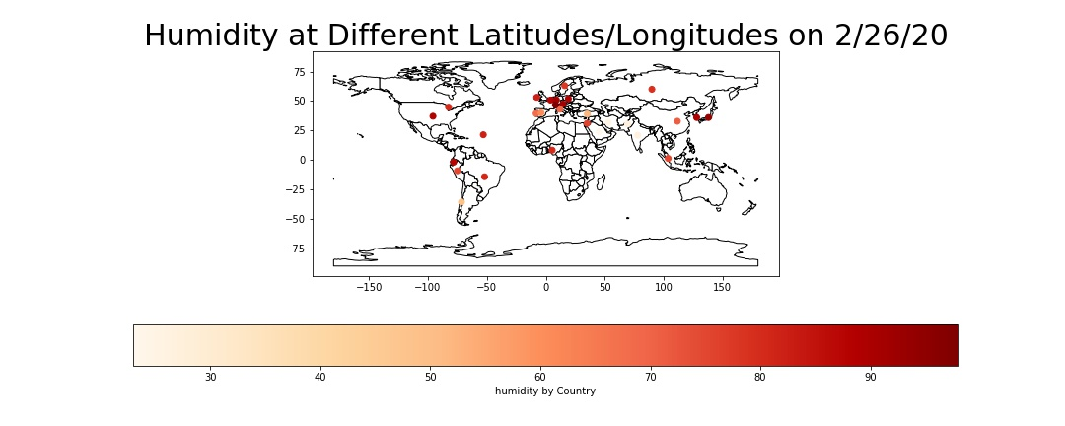
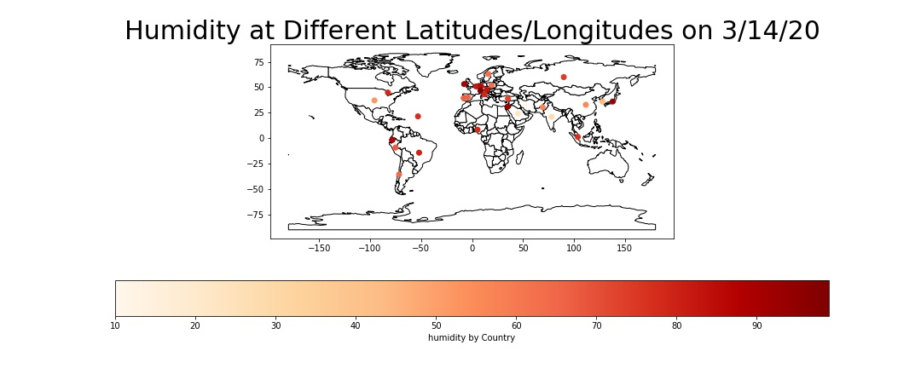


Slide 14
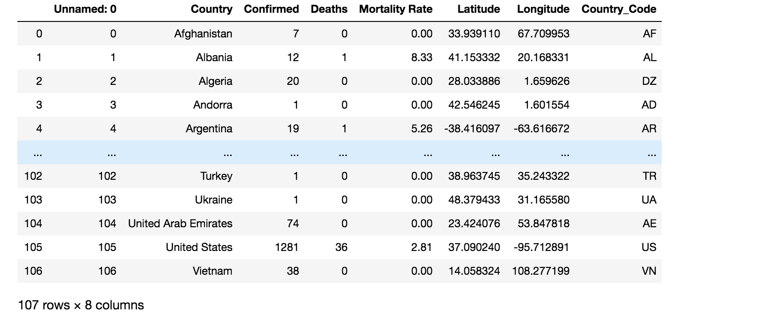
Mortality Rate - Data Set

Slide 15
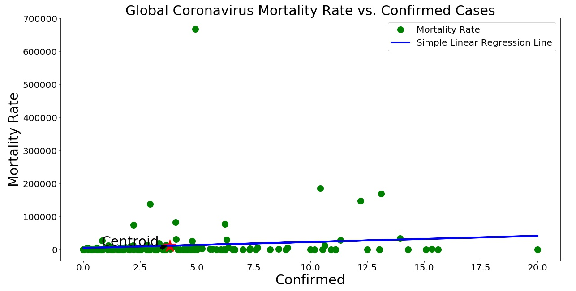
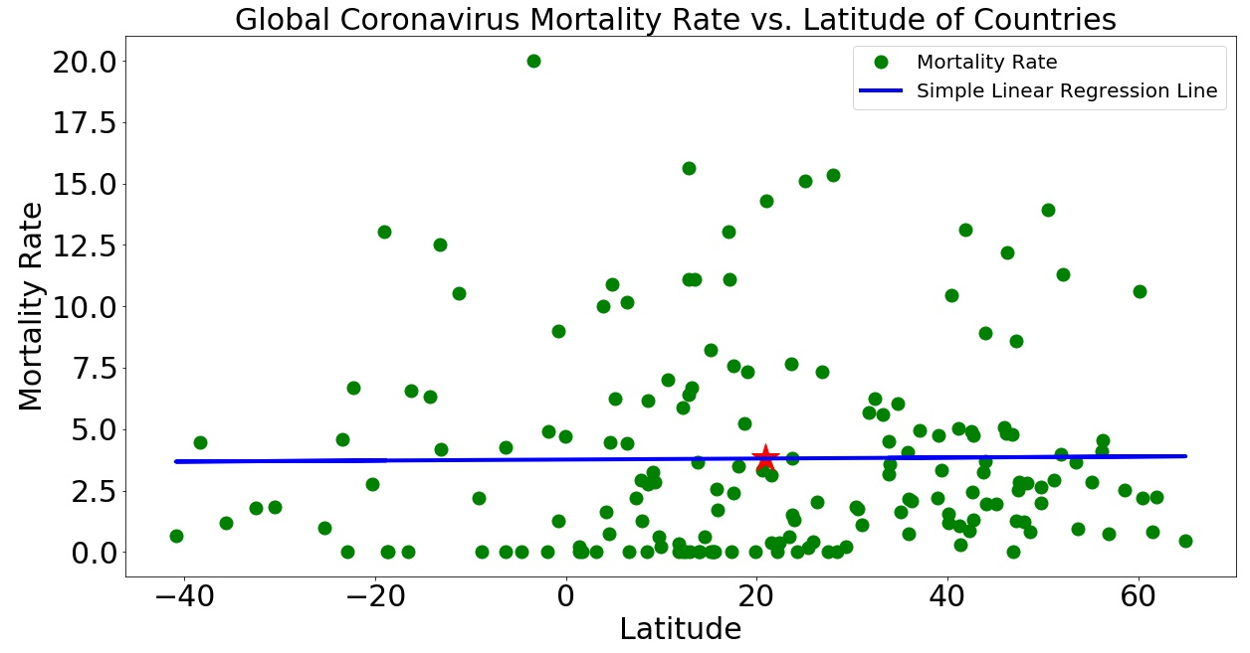
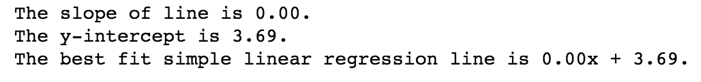
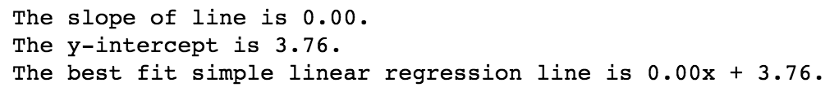

Slide 16
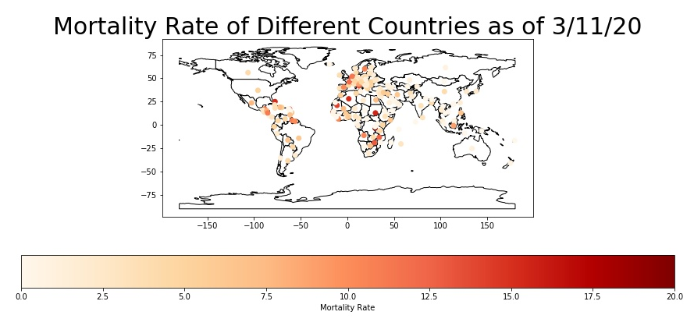

Slide 17
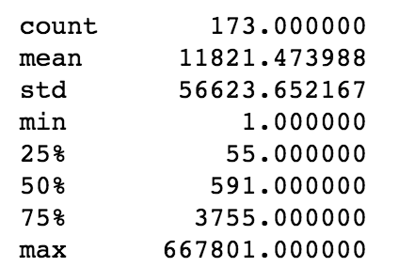
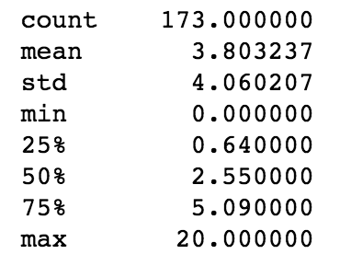
Mortality Rate - Descriptive Analysis
Confirmed Mortality Rate

Slide 18
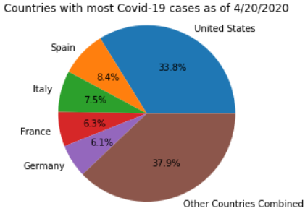
Countries affected by Covid-19
We decided to focus on the United States specifically since it has the most cases of Covid-19 compared to all other countries as shown here.

Slide 19
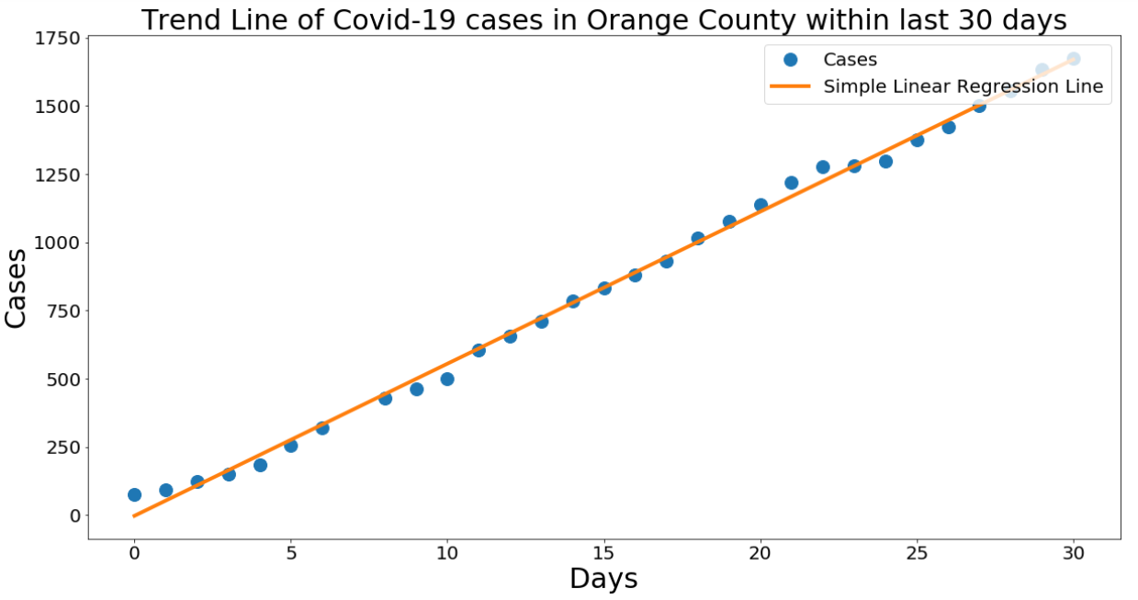
California Counties - Graph
Trend Line shows that each day about 55 cases occur. Dates go from 3/21 to 4/20.

Slide 20



California Counties - Data Sets
Counties in California with date, maximum temperature, minimum temperature, humidity level, and ozone level, on each date since beginning of 2020. We currently are working on these 3 areas, due to Orange and Los Angeles being neighbors, and Santa Clara being far away, and having different climate

Slide 21
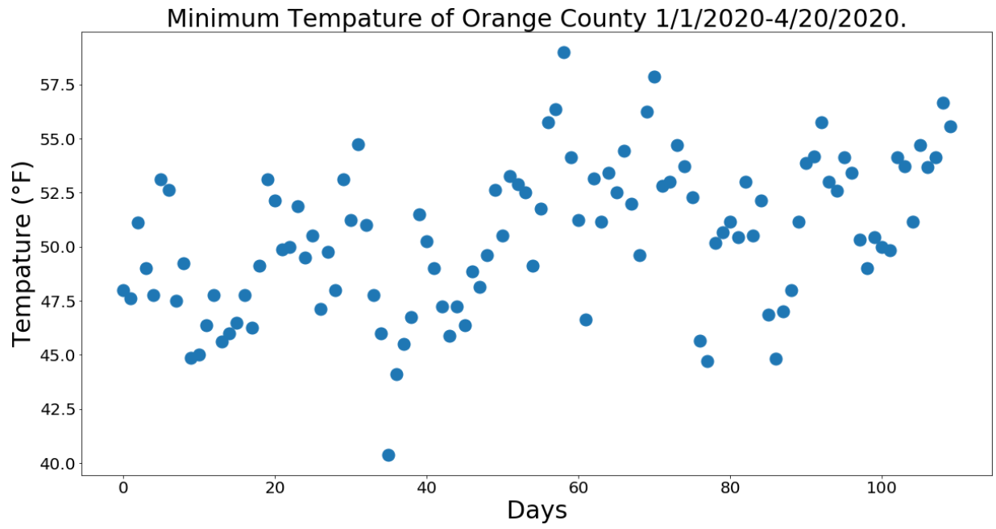
Exploratory analysis of Temperature
Minimum temperature, in Orange County consistency is with in a 10 degree range 45-55 F with a of mean 50.52 °F and Standard Deviation of 3.40 °F. Showing that minimum temperature on average is consistent.

Slide 22
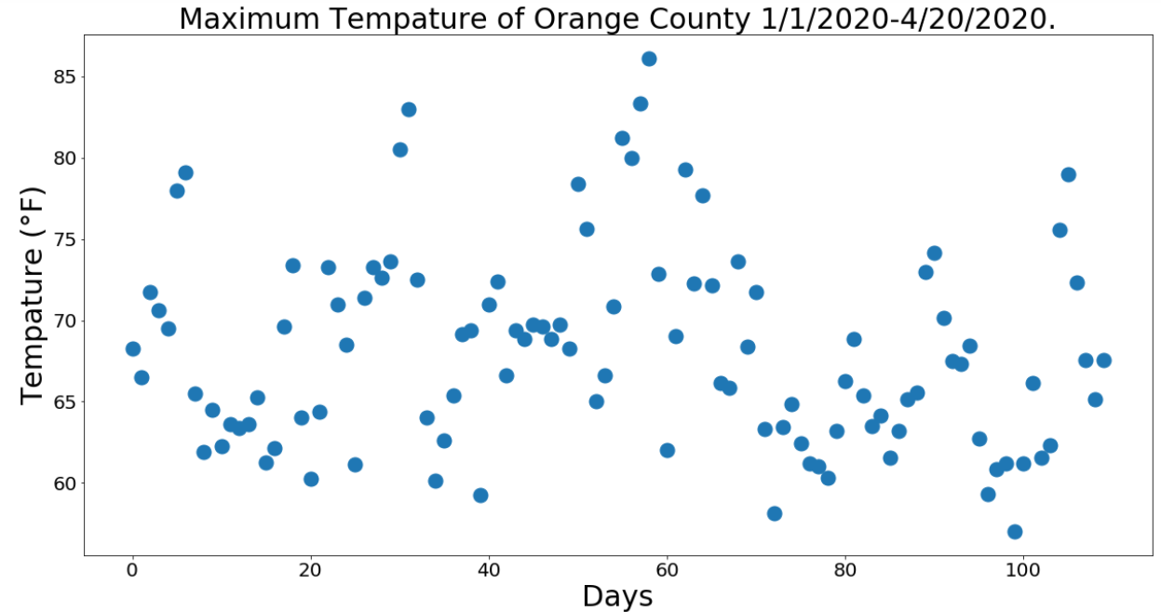
Exploratory analysis of Temperature
Maximum temperature, in Orange County fluctuated more than Minimum temperature. The mean is 68.12 °F and Standard Deviation of 6.10 °F. This shows that maximum temperature is volatile.

Slide 23
Exploratory Analysis
What we found interesting is that as latitude of the countries increases, mortality rate slowly increases and then decreases. The highest mortality rate recorded was 20% at latitudes ranging from 20-40. Outside of latitude ranges 20-40, mortality rate started to decrease sharply to 0.0. This mortality-latitude relationship is likely due to humidity at those latitudes. Humidity level and ozone level graphs both show a positive correlation between humidity, ozone, and latitude of countries respectively. After latitude 40, humidity levels increase from 40% to 60% and ozone levels increase up to 350 dobson units on 3/14/20 (Pi Day).
According to the Mortality Rate of Different Countries graph, there are higher numbers in infection cases in latitudes 40 to 50 than others. This latitude range includes the United States, Europe, and China. Europe has the highest mortality rate at a glance.
As well as that many counties in California have some consistent climate patterns, such as Humidity, ozone, and minimum temperature. While max temperature can vary.

Slide 24
Descriptive Analysis
Around latitude 40, many locations have a humidity ranging from 60 to 90 and ozone levels ranging from 275 to 350. This latitude also has more cases of coronavirus than other latitudes. Through initial explorality , this point is shown further evidence as the standard deviation of Ozone, was low, which is very small. So using this data we realized that Ozone won't change much over time and thus will most likely not contribute much to the spread or slow down of Corona.
Looking at the Ozone Measure at Different Latitudes/Longitudes graph, there are high ozone levels in China and Europe. This correlates with the mortality rate graph previously mentioned and shows some relation in high ozone to high mortality rate. However it is important to consider the cause-effect relation, proving there could be no effect on coronavirus from ozone.
We also noticed the standard deviation of minimum temperature to remain consistent for many counties from the standard deviation; thus won’t be as useful as maximum temperature.

Slide 25
Hypothesis:
Since, the max temperature fluctuates, it could have an impact on how much Covid-19 spreads, due it’s lifespan changing because of the different temperatures. Since the minimum temperature remains consistent it’s not much of a variable, since it doesn’t change much. However since Maximum Temperature can change a lot we can say that if there is an extended period of time of hypothetically a max temperature range of 80-90 that the disease will survive only for a shorter period of time, instead of a of range 70-80. SARS has multiple studies of how it’s affected by temperature ranges, and we are currently narrowing down a source for Covid-19. Since SARS is similar to Covid-19 we are assuming that they will have same temperature range of survival but we are trying to pick a source specifically for Covid-19 instead of SARS. So at this point we don’t have concrete evidence. But we are working on it.

Slide 26
Predictive Analysis
Using past and current data of coronavirus and weather, we can predict how coronavirus will spread in the future. Along latitude 40, cases of coronavirus will exponentially increase.

Slide 27
Prescriptive Analysis
Based on our information, it is advised to follow whatever necessary to prevent the spread of coronavirus. Latitudes with moderate high weather have the most cases of coronavirus. No matter what latitude, coronavirus can still exist and spread.

Slide 28
Conclusion
Coronavirus shares many similarities with the SARS virus in its country of origin, climate, scale, and transmission. With such similarities between these two viruses. it is worth noting that SARS is directly affected through environmental factors such as the weather.
Based on our research, weather can have an effect on coronavirus. We can see that the number of confirmed coronavirus cases varies differently based on humidity. Countries located on the 40th parallel north, which spans across the United States and China, will see an exponential decrease in coronavirus cases as the weather becomes warmer. In our research, we decided that since the ozone's standard deviation was low, there is not enough direct evidence in affecting weather other than being consistent in our graphs’ data.
Coronavirus is still spreading nearly everywhere. There are more than 152 countries that have coronavirus cases. We are against the clock. We must do as much as possible in order to flatten the curve and stop the coronavirus pandemic.

Slide 29
References
https://www.ncdc.noaa.gov/cdo-web/results
https://www.kaggle.com/eeemonts/weatherclimate-data-covid19
https://www.hindawi.com/journals/av/2011/734690/
https://www.ncbi.nlm.nih.gov/pubmed/15709076
https://www.kaggle.com/paultimothymooney/coronavirus-covid19-mortality-rate-by-country/data
https://www.who.int/ith/diseases/sars/en/
https://www.medrxiv.org/content/10.1101/2020.03.12.20034728v3
https://datacarpentry.org/python-ecology-lesson/05-merging-data/
https://www.kaggle.com/fireballbyedimyrnmom/us-counties-covid-19-dataset
https://www.kaggle.com/paultimothymooney/coronavirus-covid19-mortality-rate-by-country
Fresno State slides from CSCI 191T - Big Data used:
Clustering, Sample Characteristics-Pandas, Python Basic 2, Lecture 7

Slide 30
References used for research and datasets
[1] J. Tan, e. a. An initial investigation of the association between the sars outbreak and weather: with the view of the environmental temperature and its variation (2005).
[2] Miguel B. Araujo, B. N. Spread of sars-cov-2 coronavirus likely to be constrained by climate (2020).
[3] Sonal Gupta, e. a. Effect of weather on covid-19 spread in the us: A prediction model for india in 2020 (2020).
[4] Mohammad M. Sajadi, e. a. Temperature, humidity and latitude analysis to predict potential spread and seasonality for covid-19 (2020).
[5] Alex W. H. Chin, e. a. Stability of sars-cov-2 in different environmental conditions (2020).
[6] Qasim Bukhari, Y. J. Will coronavirus pandemic diminish by summer? (2020).
[7] Stephen M. Kissler, e. a. Social distancing strategies for curbing the covid-19 epidemic (2020).
[8] Kim, K. H. Covid-19 (2020).
[9] Adam, D. Special report: The simulations driving the world’s response to covid-19 (2020).
[10] Zhong Sun, e. a. Potential factors inﬂuencing repeated sars outbreaks in china (2020).
[11] Barbara Oliveiros, e. a. Role of temperature and humidity in the modulation of the doubling time of covid-19 cases (2020).
[12] Yueling Ma, e. a. Effects of temperature variation and humidity on the death of covid-19 in wuhan, china (2020).
[13] Ravi Rai Dangi, M. G. Temperature, population and longitudinal analysis to predict potential spread for covid-19 (2020).
[14] eeemonts. Weather/climate data for jhu’s covid19 sites (2020).
[15] Mooney, P. Coronavirus covid-19 mortality rate by country (2020).
[16] NOAA. Daily summaries california counties (2020).
[17] MyrnaMFL. Us counties covid 10 dataset (2020).

